Slide 1
Static Ram Memory Systems Design
Asynchronous Sram Technology
  Internal Architecture of the Async Sram Chip.
  Operation of a Single bit Sram Cell – read/write operation.
  Important Asynchronous Sram Timing Parameters
Synchronous Sram
Dual Port Sram
©Paul Davies. Not to be copied, used, or revised without explicit written permission from the copyright owner.
This lecture may contain animations and is best viewed as a slide show

Slide 2
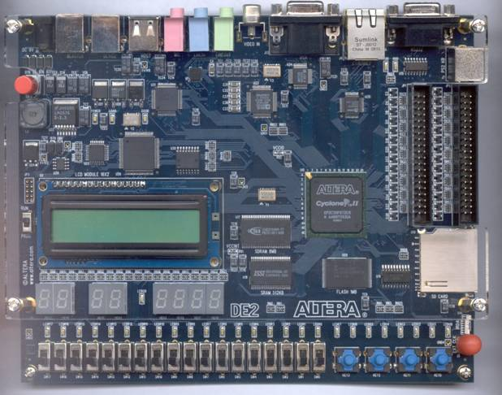
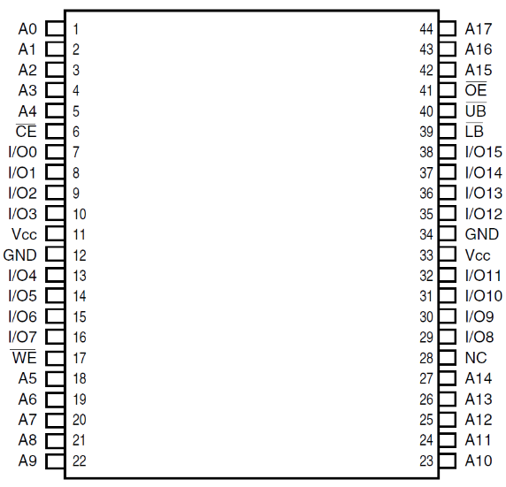
Asynchronous Static Memory on the DE2
The vast majority of Sram chips are asynchronous, i.e. they do not use a clock. Operation is defined by signals levels (0/1) rather than clock edges.
The DE2 board has an external 256k x 16 asynchronous Sram chip made by ISSI, as well as some synchronous Sram on the FPGA.
The DE1SoC only has synchronous Sram inside the FPGA.
68k CPU
32k Rom
16k SSRam
512k
Sram
IS61LV25616

Slide 3
General Architecture of an Asynchronous Sram Chip
Internally an Sram chip is organised as an array of memory locations.
Each location is able to store 1 or more bits. Defined by the width of the Data Bus.
‘M’ address lines are internally decoded to select 1 unique location from 2^{M} locations.
Bi-directional data bus driven by chip (when reading) or CPU (when writing)
Address Bus driven by CPU to access a location.
Internal Address
Decoder
Array of 2^{M} memory Locations each storing N data bits
Bi-Directional,
Tri-stateble Input Output buffers
‘M’ Bit Address Bus
‘N’ Bit Data Bus
‘N’ Data Bits
IMPORTANT: Internal Address Decoder is active all the time. It does not need OE or CS to become active to start the process of decoding the address, so give address a.s.a.p. to speed up access to data.
WE determines direction of data bus enabling.
1 output from decoder selects a unique location within the chip.
CS
OE
WE
CS used to enable input/output buffers inside chip for reads & writes (generated by an external address decoder).
OE used to enable/disable output buffers at start and end of a read cycle for faster “turn off” of buffers. Can be tied to logic 0 if not required.

Slide 4
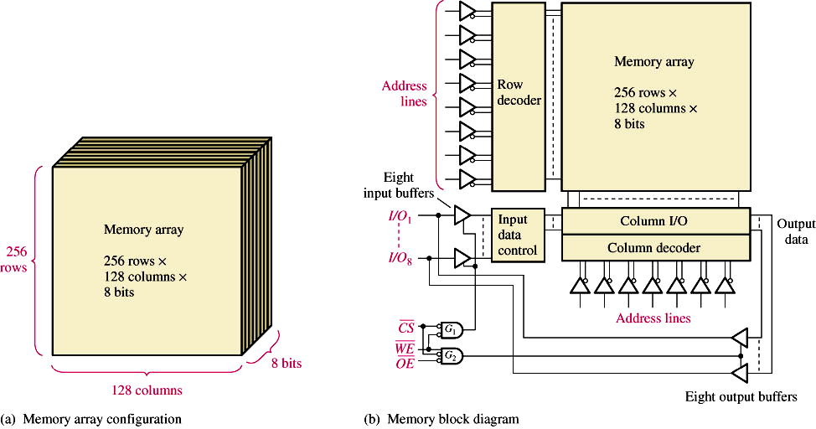
Architecture of a typical 32k x 8 Asynch Sram Chip
To simplify the internal address decoder, a 32k device (with 15 address lines) is physically organised into two smaller row and column decoders.
The Row decoder is fed with 8 (of the 15) address lines selecting 1 of 256 rows.
The Column decoder is fed with the remaining 7 address lines selecting 1 out of a possible 128 columns. Intersection of row and column decoders selects a location.
2 dimensional array of 256 rows by 128 cols each storing 8 bits.
Memory Array
256 rows x
128 columns x
8 bits
8 Bit Row Address
Row
Decoder
Intersection of a row and column decoder output used to select a location of ‘8’ bits
Eight
Input Buffers
8 Bit Bi-directional Data Bus
Input Data Control
Sense Amplifiers
OutputData
Column Decoder
Tristate Output buffers turned on when WE = 1, CS = 0 and OE = 0
CS comes from the external address decoder, OE used with a CPU valid address signal (to avoid bus contention) or ‘0’
7 Bit Column Address
Input buffers enabled for writing whenever WE = 0, CS = 0. Can lead to false writes if address is not valid (WE should be gated with 68k’s AS signal to avoid false writes.)
Eight Tri-state Output Buffers

Slide 5
Static Memory Technology
Back to back inverters have 2 stable states
Static (Sram) Memory Cell
The illustration opposite is that of an Sram cell able to store a single bit of data.
The two back-to-back inverters reinforce each others output. This arrangement provides two stable states at the output of each inverter: ‘0’ or ‘1’.
The other two Mosfets control activation of the cell for reading and writing purposes and are activated by the memory chip’s internal address decoder, that select this cell within the chip.
Cell Select
1 Bit Memory Cell
Data in/out
Data in/out
To Sense Amplifiers and Output Drivers on chip
for fastest response time

Slide 6
Static Memory Technology
6T and 4T implementations of an Sram cell.
By replacing the P-Type Mosfets in the 6T implementation with high-resistivity polysilicon resistors (~1 GΩ), a physically smaller 4T Sram cell can be produced.
P Type Mosfet conducts when gate is at logic 0
Acts as a pull up resistor
+V_{dd}
+V_{dd}
P Type
In = 0, out = 1
In = 1, out = 0
In = 0, out = 1
In = 1, out = 0
N Type
N Type
N Type Mosfet conducts when gate is at logic 1
N Type Mosfet conducts when gate is at logic 1
Inverter Implementation in a 6T Cell
Inverter Implementation in a 4T Cell

Slide 7
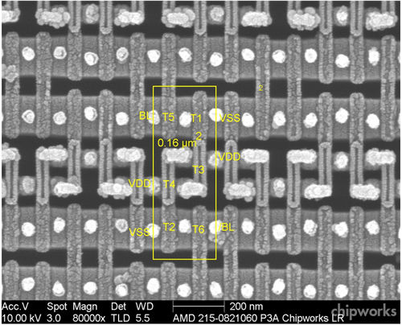
Static Memory Technology
Illustration of a 6 Transistor Sram Cell taken from AMD Radeon HD 7970 graphics processor. Total area = 0.16 microns²

Slide 8
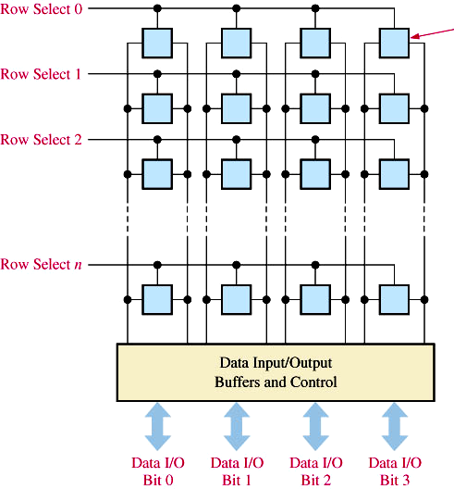
Static Memory Technology
The illustration below shows how a 4 bit wide memory chip might be organised internally.
Each blue cell corresponds to the 6 transistor implementation seen previously, capable of storing a single bit of data. In this example, 4 cells are activated by each cell select.
The cell selects correspond to Row and Column decoder outputs (And’ed together.)
Cell Select
Cell Select 0
Equivalent too
b0
b1
b2
b3
Cell select 1
Cell Select 1
b0
b1
b2
b3
Cell select 2
Cell Select 2
b0
b1
b2
b3
1 Bit Memory Cell
Data in/out
Data in/out
Cell select 2
Cell Select ‘N’
b0
b1
b2
b3
D0
D0
D1
D1
D2
D2
D3
D3
Row Decoder Output
Sense Amplifiers and Data Input/Output Buffers
&
Cell Select
Column Decoder Output
Data I/O
Bit 0
Data I/O
Bit 1
Data I/O
Bit 2
Data I/O
Bit 3
Cell select signal comes from the bitwise ‘AND’ of the Row and Column Address Decoder line outputs

Slide 9
Static Memory Technology
Reading
The cell select is activated in response to a CPU address by AND’ing the outputs from the internal row and column decoders.
This turns on the two control Mosfets and the opposing inverter outputs are fed to a sense amplifier which produces a logic 0 or logic 1 at the chip output.
From Decoder
Cell Select
1
Mosfet Conducts
Mosfet Conducts
0
1
1 Bit Memory Cell Storing Logic 0
0
1
Data Out
Data Out
To “on chip” Sense Amplifiers and Output Drivers for fastest response time

Slide 10
Static Memory Technology
Writing
The cell select line is taken high in response to a CPU address.
The CPU’s data is driven into the Data in/out line (and its inverse). The higher power control Mosfets overpower the inverters forcing them to adopt the chosen stable state.
From Decoder
Cell Select
1
Mosfet Conducts
Mosfet Conducts
1
Inverters ‘FLIP’ to Driven Value
0
0
1
1 Bit Memory Cell Storing Logic 1
1 Bit Memory Cell Storing Logic 0
Data Driven IN
Inverted Data Driven IN
1
0
Data in
Data in

Slide 11
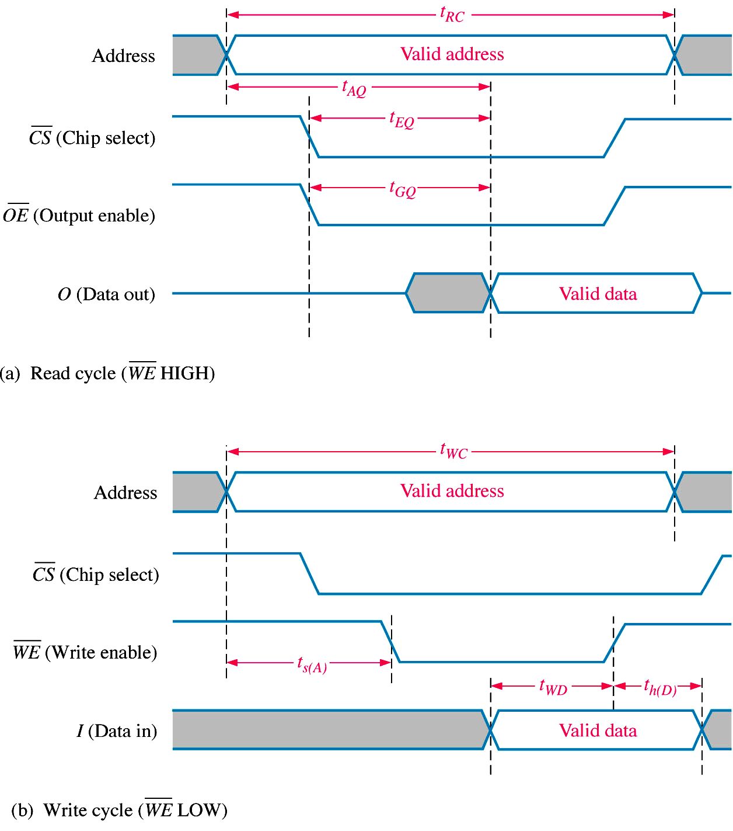
Asynchronous Static Memory – Read Cycle Timing
An appreciation of the timing characteristics of an Async Sram chip is essential for determining if a specific device will interface to the CPU correctly. For example, is it fast enough to supply the data, during a CPU read operation.
t_{RC} – The Read Cycle Time of the chip, the MINIMUM time address should be presented. Chip not guaranteed to read successfully if address not stable for at least this length of time.
t_{AA} – The worst case Read Access Time of the chip after address becomes stable. A key parameter engineers look for.
t_{AA}
CE (Chip Enable)
t_{ACE}
t_{DOE}
t_{ACE} and t_{DOE} – The worst case time taken to turn on the output buffers of the chip after presentation of CE and/or OE. Data out can be delayed if either signal is late or delayed.
Key design decisions for READ operation:
1) Make sure CE and OE arrive early so as not to delay turning on output buffers inside the memory chip during a read (usually easy)
2) Get the CPU address to the chip ASAP don’t wait for AS. This means internal decoders can go to work on the address quickly.
3) Make sure CPU waits at least T_{AA} seconds before “reading” Data.

Slide 12
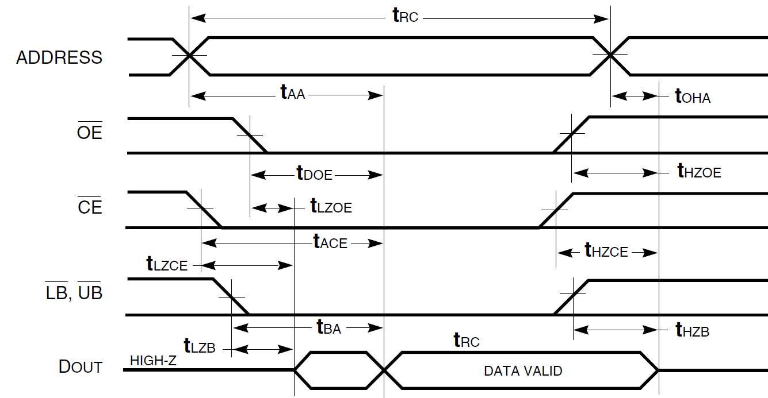
Example Static Ram Memory Chip
The DE2’s ISSI IS61LV25616-10 – 256k x 16 Important Read Access Parameters
LB/UB select bytes for 8 & 16 bit access. Could connect to 68k’s LDS & UDS signals
Parameter Symbol Min Max (worst case)
Read Cycle Time t_{RC} 10ns
Address Access Time t_{AA} 10ns
Chip Enable Access Time t_{ACE} 10ns
Output Enable Access Time t_{DOE} 4ns
Byte Enable Access Time t_{BA} 4ns

Slide 13
The DE2’s ISSI IS61LV25616-10 – 256k x 16 Important hold Parameters, i.e. how long data out persists after removal of key read operation signals.
Parameter Symbol Min Max (worst case)
Data Output Hold Time From Address Remove t_{OHA} 3ns
OE to High-Z Output t_{HZOE} 4ns
CE to High-Z Output t_{HZCE} 4ns
LB, UB to High-Z Output t_{HZB} 3ns

Slide 14
Other Timing Considerations
The block diagram below shows a simple 68k CPU interfacing to a 256K word memory chip.
The Parameters, t_{PAB} , t_{PAD} , t_{PDB} and t_{AA} indicate the various signal propagation delays and access times that may be encountered (depending on inclusion of buffers etc.) along the way, during a CPU read cycle.
Time t_{DSU} is the data setup time back at data bus of the CPU.
When CPU outputs an address, it expects to sample the data some time later. We do the timing analysis and make sure that our data is back at the CPU in time to be read.
t_{PAD}
Address
Decoder
Chip Select
Address
Decoder
t_{PAB}
Dtack
CS
CPU
Address
Bus
Buffers
A₁₉- A₂₃
Address
Buffers
A₀₁- A₁₈
A₁- A₂₃
A₀- A₁₇
AS
OE
R/W
logic
WE
256K x 16
Sram Chip
UDS
UB
LDS
LB
Data
Bus
Buffers
Data
Buffers
Access time from stable address (t_{AA}) or from CS* (t_{ACE})
D₀- D₁₅
D₀- D₁₅
68k
t_{DSU}
NOTE: Propagation delays inherent in the wires such as the Address and Data bus have been ignored
t_{PDB}
t_{AA or} t_{ACE}

Slide 15
Typical CPU Read Cycle Timing
The timing diagram below shows a simple but typical 68k read cycle in action.
An address is issued, and some time t_{TOTAL} later, after Dtack is received, the CPU will expect the memory system to have decoded the address and supplied the data back at the CPU data inputs.
We can see that in order for the memory system to work correctly for a CPU read
  t_{TOTAL} > t_{PAB} + t_{AA} + t_{PDB} + t_{DSU}
  t_{TOTAL} > t_{PAB} + t_{PAD} + t_{ACE} + t_{DSU}
t_{TOTAL}
A₀- A₂₃
D₀- D₁₅
Address Valid Here
Data Bus Sampled here
Dtack

Slide 16
Synchronous Sram

Slide 17
Synchronous Sram (SSRAM) is a development of Asynchronous Sram for very high speed systems and uses a clock synchronised to the CPU. Frequently used as cache memory in CPU (as well as external memory).
Same basic internal architecture as asynchronous Sram e.g. (6 Mosfets per bit) etc as well as (for external devices) signals such as CS*, R/W* etc.
However those asynchronous signals (CS*, Address Bus, Data Bus, R/W*). are latched (registered) internally on a clock edge, meaning address and data-in do not need to be held stable by CPU for duration of read/write, i.e. they can change while read/write is in progress making successive accesses faster e.g. pipelining.
Data out may also be latched as an option, but this delays access to memory data by 1 more clock cycle.
Some SSRams may have internal address counters to auto increment the last address, allowing burst reading or writing of data from/to chip, one data item per clock, without the need for a new address to be issued by the CPU. Others may need a state machine based memory controller to handle this feature if required.

Slide 18
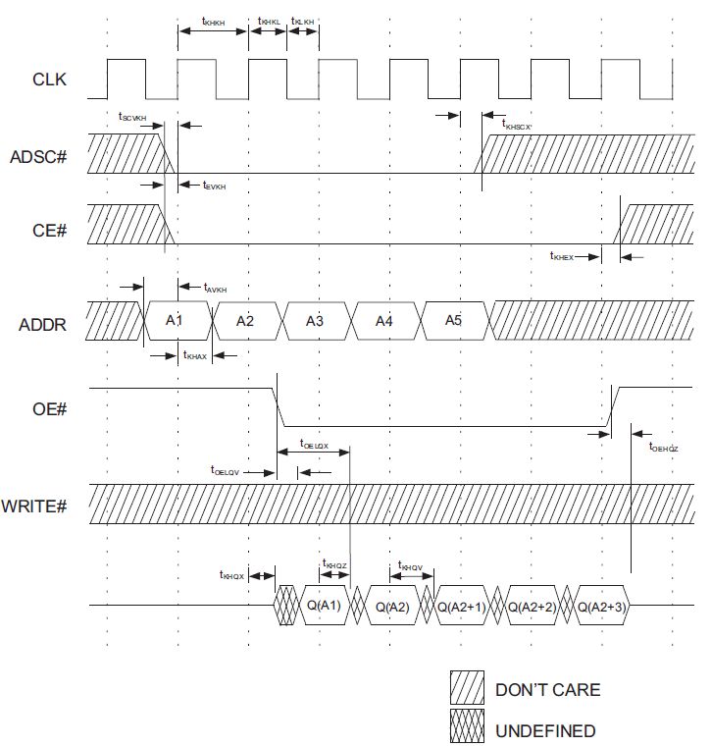
An example of a SSRAM chip read cycle timing is shown below for the Microsemi WED2DL32512V 512k x 32 pipelined, burst mode device.
CE, WE, Address (and Din) signals latched internally on rising clock.
In non burst mode, data out available on next clock edge, assuming OE_L asserted. Bursting great for Graphics and Cache design.
Clock
Addr Latch
CE_L
Address
OE_L
WE_L
In burst mode, successive data items available per clock and no new address
Data Out
Q(A1)
Q(A1+1)
Q(A1+2)
Q(A1+3)
Q(A1+4)
1st item of data available on next clock, OE_L timing shown here delayed by 1 clock.
Output buffer turn on time from OE_L

Slide 19
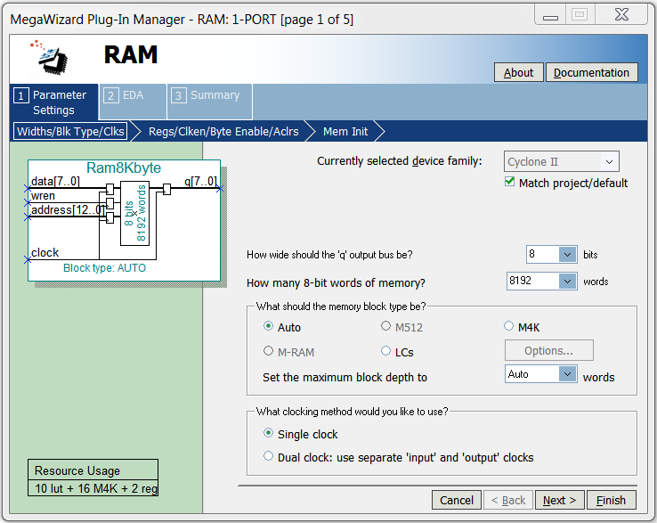
Synchronous Sram
Altera's FPGAs only support SSRam. An example illustration of the Mega Wizard in Quartus being used to construct 8k bytes of SSRam is shown below.
You can clearly see the registered inputs and outputs to latch external signals.
Output is always driven, may need tri-state output buffers to build up memory banks.
Note: No CS or OE, just WREN which also has to serve as a CS during writes.

Slide 20
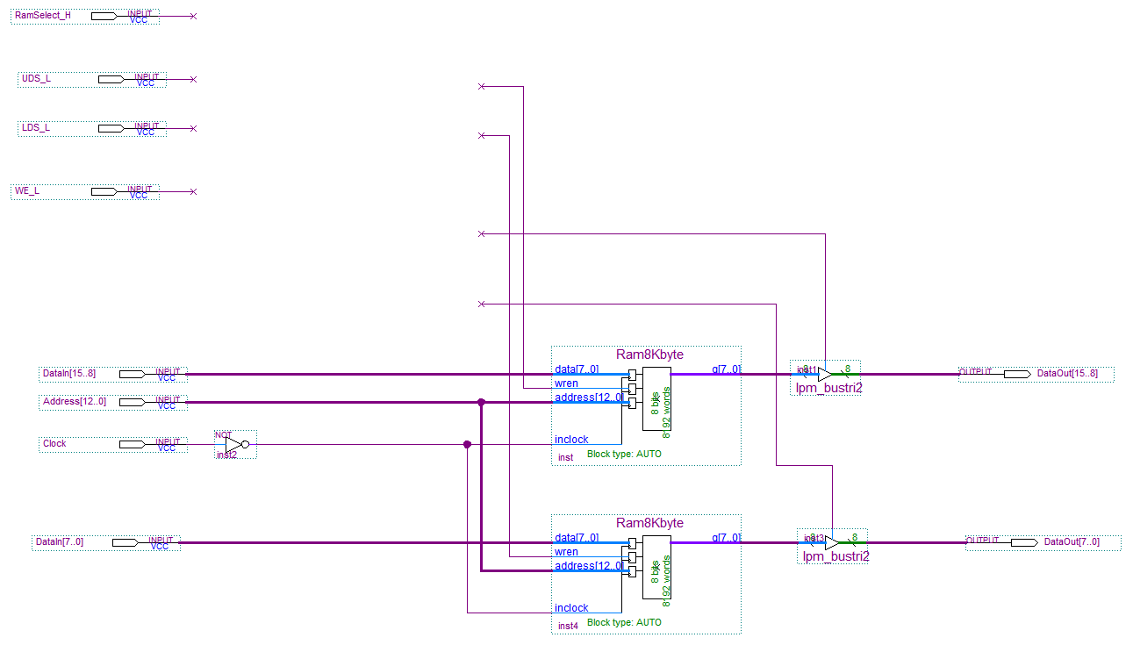
Synchronous Sram
Exercise 1: Design logic for 68k to drive the FPGA SSRam and turn on output buffers below during a read. Buffers should only be turned on when block of memory is selected.
Don’t worry about timing at the moment, just functionality

Slide 21
Tri-State Memory Outputs
Exercise 2:
Why do external memory chips always have tri-state outputs?
What is wrong with just connecting all memory device data outputs directly to the CPU databus?

Slide 22
Dual Ported Sram
Dual Port Sram has two address, data and control buses to allow two devices to simultaneously share the same memory without external synchronisation or multiplexing of a single set of address/data/control signals.
Less common to see external dual port ram chips due to the large number of physical pins required. However it’s common inside ASICs and FPGAs.
Application 1: - Multi-processor communications:
Two CPUs can communicate/share data through the use of dual port Sram
Some Sram chips have built in hardware semaphores for processor synchronisation so that read/modify/writes by two processors to the same locations do not interfere, e.g. when two processors are trying to increment the same shared variable in memory at the same time, one will be delayed until the other completes.
CPU 1
Address
Dual Port Memory
Address
CPU 2
CPU 1
Dual Port Memory
CPU 1
Data
Data
R/W etc
R/W etc

Slide 23

Dual Ported Sram
  Application 2: Video Memory frame buffer
  Dual port memory also enables a video display controller to display images at the same time as the CPU/GPU is updating the image (i.e. writing to video memory).
  This reduces flicker that might occur on the display monitor if single port memory had been used (due to the GPU taking control of the memory chip’s single port during drawing/writing.) and eliminates the external multiplexer that would otherwise be required to switch memory buses between Video and GPU.
  It also means the GPU can draw a new image at full speed without having to wait for the horizontal and vertical “sync” periods when the video controller is not displaying an image (at the end of a line or frame).
CPU
Graphics Processor
(GPU)
Address
Dual Port
Video Memory
(Frame Buffer)
Address
Video Display
Controller
CPU 1
CPU 1
Dual Port Memory
CPU 1
Data
Data
R/W
R/W
VGA/HDMI etc
Drawing
Displaying

Slide 24
Architecture of a Dual Port Sram Cell
From Port 0 and Port 1 Two Internal Address Decoders
Port 0 Cell Select
Port 1 Cell Select
1 Bit Memory Cell
Data in/out P1
Data in/out P0
Data in/out P0
Data in/out P1
Data in/out connected to Port 0 and Port 1 on chip Sense Amplifiers and Output Drivers for fastest response time

Slide 25
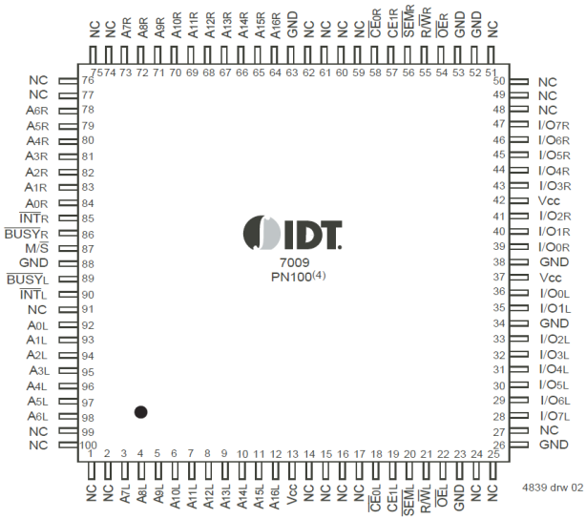
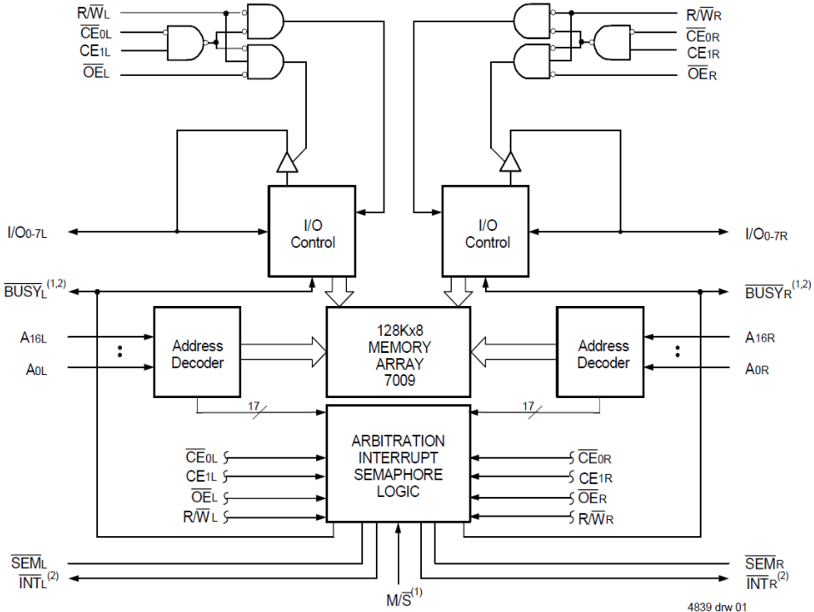
Block Diagram IDT7009L 128k x 8 Dual Port Asynchronous Sram
Eight built in Semaphores plus busy detect logic to stall one processor.
Mailbox feature allows CPU to CPU communication via interrupt pins. That is, if one CPU writes data, an interrupt is generated to the other CPU.

Slide 26
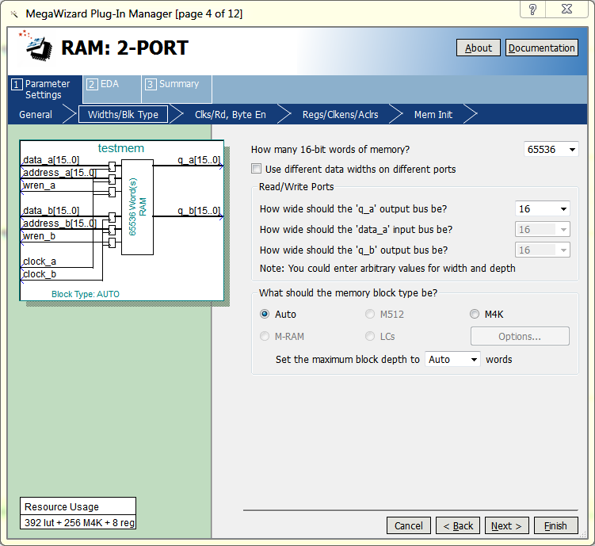
Dual Ported Synchronous Sram in FPGAs
Quartus can also synthesize dual port synchronous Sram on an FPGA
Registers on inputs to latch CPU signals. Each port can have its own clock (as shown here) or have a single combined clock.

